Slide 1
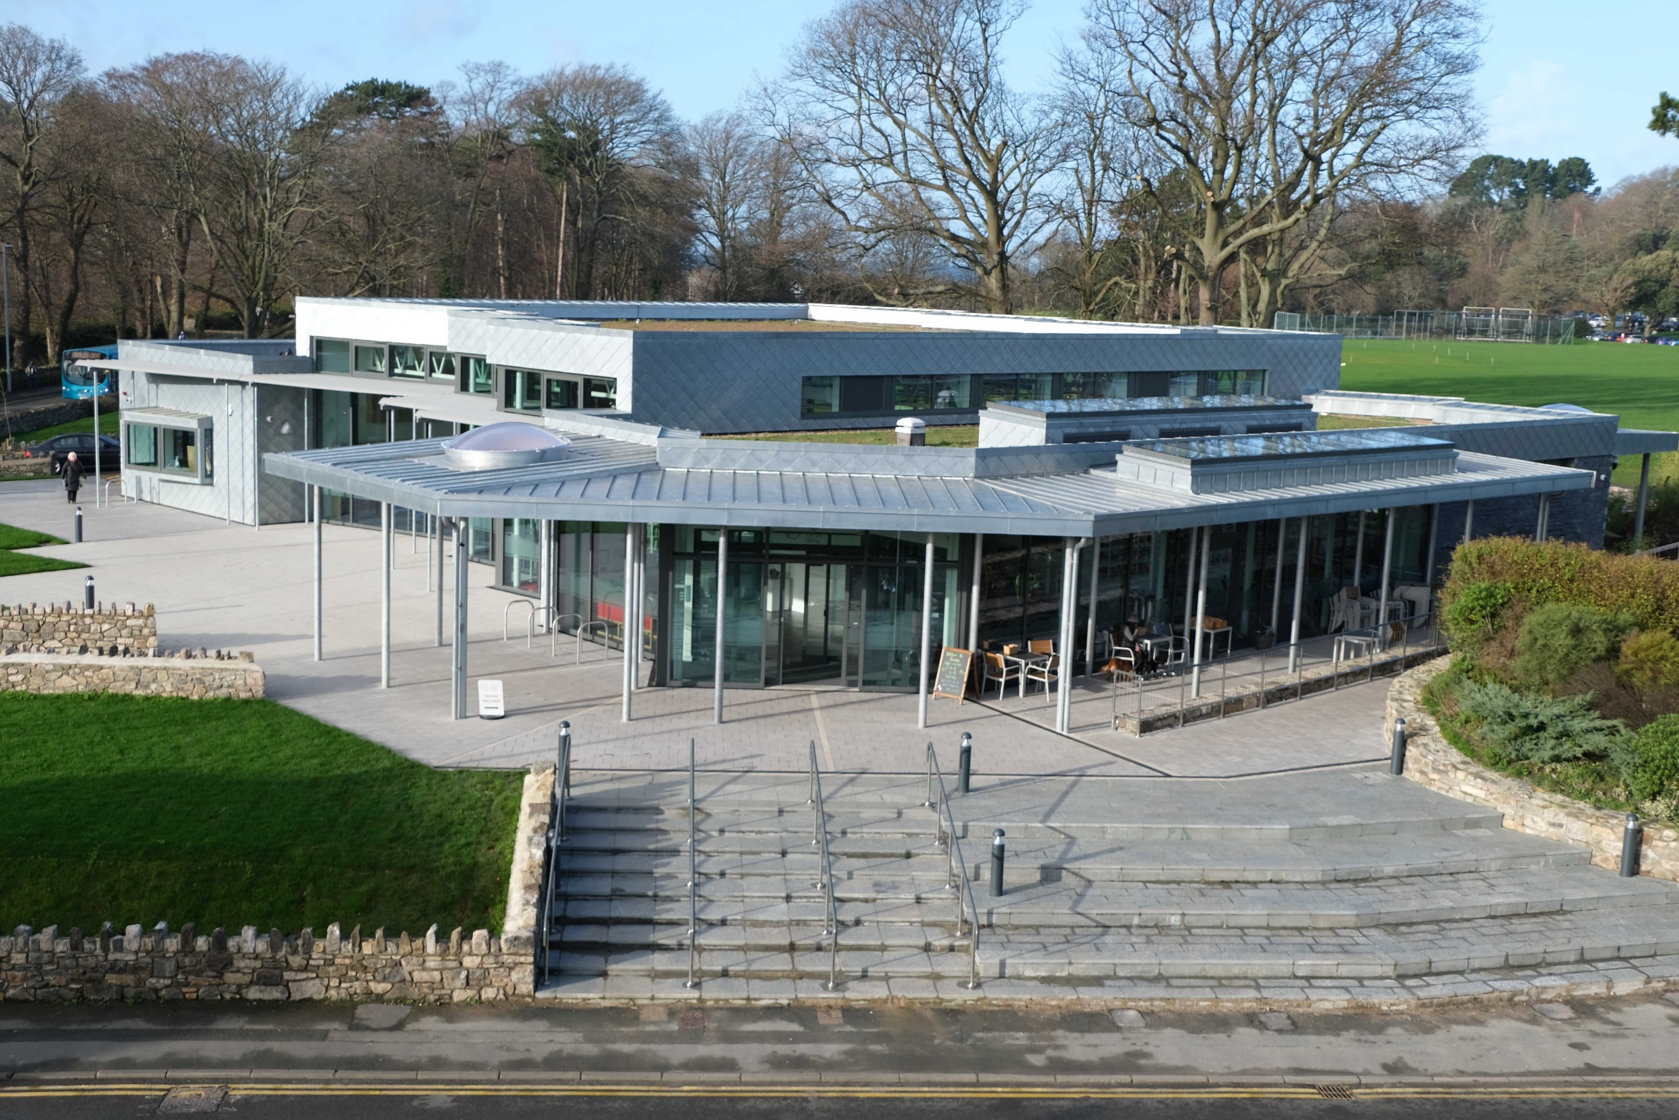
CONWY Culture Centre
Final evaluation summary
2021
© Wynne Construction Ltd

Slide 2
outcomes

Slide 3
1
95%
new heritage archive facility that meets accreditation standards
collection catalogued
OUTCOMES FOR HERITAGE
30,681
people have engaged with our heritage online
1358
people follow our heritage on social media
1
new visitor attraction
outreach events
72
OUTCOMES FOR COMMUNITIES
volunteers
1
237
61
5100
new Welsh language group established
have
donated hours
taster sessions
OUTCOMES FOR PEOPLE
45
157
10398
participants
including
young people have gained accreditation
staff, volunteers & participants have gained accreditation
3934
children
8
2
staff completed Higher Apprenticeships
work placements
- 3 -

Slide 4
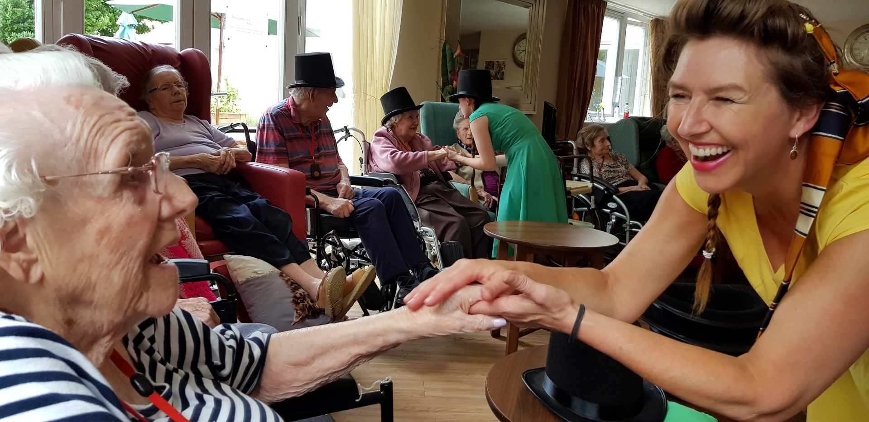
What did we want to happen?
The project set out to create a new sensitively designed and pioneering Culture Centre for Conwy town and county, providing an environment for all ages to engage with heritage.
During the planning and building process, the project aimed to safeguard Conwy’s heritage collection, deliver a comprehensive programme of heritage, arts and culture engagement throughout the county, reach new audiences that included groups that are traditionally marginalised from heritage and culture programmes, and upskill staff and volunteers.
What difference did we hope the project would make?
Heritage is better managed;
Heritage is better interpreted and explained;
Heritage is identified and recorded;
People develop skills;
People change their attitudes and/or behaviour;
People learn about their heritage;
People have an enjoyable experience;
People volunteer time;
Negative environmental impacts are reduced;
The local community is a better place to live, work and visit;
The local economy is boosted.
project outcomes
“Conwy Culture Centre is a gateway to the county’s integrated heritage and culture collections and their use for community learning, participation and enjoyment. The centre preserves and make accessible collections through the use of innovative interpretation, learning resources and activities that bring heritage to life for local people and visitors. Young people sit at the heart of what we do, working with our multi-disciplinary team to ensure that our collections remain relevant for current and future generations.”
vision
- 4 -

Slide 5
What are the outcomes?
OUTCOMES FOR COMMUNITIES
Identified by 10 Conwy Culture Centre management team and staff members
It has garnered the interests of many local people who perhaps would not have used the facilities.
Provided a beautiful, energetic space for the community to use.
The project has given the resource and impetus for numerous sub-projects that have engaged new audiences with heritage.
We have provided some tranquil spaces for community use.
We have provided community benefit through our building project – in particular, local spend.
Seeing families coming to borrow books and sit in the reading circle outside has been lovely.
The variety of opportunities for participation and engagement.
The Culture Centre has become a hub for the public, encouraging all walks of life to engage and partake in different activities.
It is a place where everyone is welcome, a safe space with no entrance fee. A free and inclusive community space is something which is now are and the Culture Centre provides that for this area
OUTCOMES FOR HERITAGE
Identified by 10 Conwy Culture Centre management team and staff members
Our heritage collections are now housed in good environmental conditions.
The collections have been better interpreted.
Heritage is more accessible and part of the local community.
Archive and museum collections are now safely housed in a state of the art strongroom after being in inadequate accommodation for many years.
The Archives are more visible and accessible.
Safeguarding our collections – archives and museums.
Our collections are better stored, interpreted and managed now as a result of the project.
Our museum collections are now more accessible as more of them are on display.
We have collected significant new oral heritage through the People of Conwy project which complements our collections.
Built a new purpose-built archive.
- 5 -

Slide 6
What are the outcomes?
OUTCOMES FOR PEOPLE
Identified by 10 Conwy Culture Centre management team and staff members
We’ve upskilled volunteers and apprentices (the latter also through the building project).
We’ve changed perceptions, e.g. young people and Welsh language and culture.
It has given the space a new lease of life and celebrated the school and its history. This has been very important for its former students, as it’s a time of reflection and it’s been wonderful to showcase its original use.
We have provided training, volunteering opportunities and accredited learning for people, contributing to their skills and employability, and soft skills. We have supported and engaged with people experiencing sensory loss and helped to make our collections more accessible and relevant.
We have created a welcoming, accessible and supportive learning environment at the centre that provides a modern resource for visitors.
People have had a real resurgence of interest in their local history and have delighted in having conversations about past memories and how the building will now shape their present ones
.
- 6 -

Slide 7
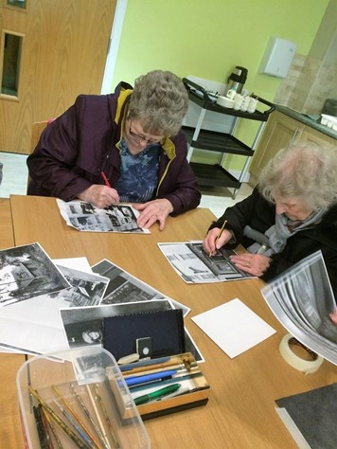
what have we learned?

Slide 8
what are
visitors saying?
“Great library layout and stock.”
“A really nicely put together and managed centre.”
“Very good and more room to move.”
“Good selection of books in a very pleasant room with plenty of light through the glass…”
The archive feels safe and easy to use; it’s bright.
The garden – it’s just a lovely place to be
Whole building – a glass box that feels open and accessible
The archive search room – comfortable and welcoming
The fact that it’s a joint space; a good idea
Main library – it is spacious airy and contemporary
- 8 -

Slide 9
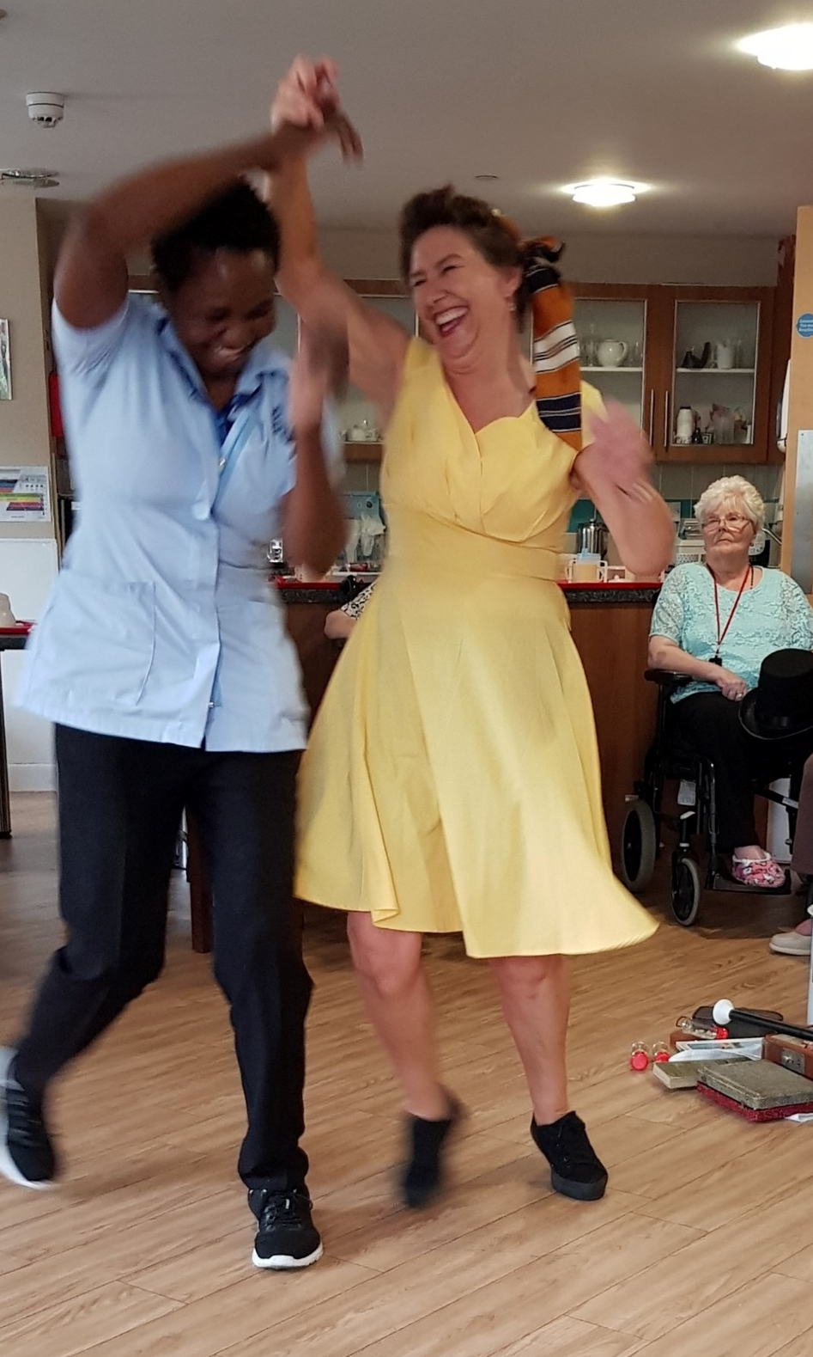
Learning from the project delivery
If you had the opportunity to do this type of project again, what would you do differently?
8 members of the Conwy Culture Centre project management team and staff responded to this question as part of the final evaluation of the project. For them, the learning centres on the experiences of developing the interpretation displays and the extent to which they would have kept that ‘in-house’, which has been a recurring theme across each project evaluation. Their responses are direct quotes and they have been post-categorised under main headings:
Interpretation
Appoint a member of project staff to undertake research and write interpretation.
I would not have paid an interpretation consultant to do the concept / ideas side of this design. Staff ended up doing the research themselves and much time was wasted on an outside company ‘not getting it’.
Work with a different interpretation team.
Working with people and collections
Perhaps have more staff space for more volunteers to work with us on site.
I wish we could have even more staff interaction, staff working in the library and archive areas, to further increase understanding of collections / the offer / the requirements of the different customer base. It all works really well, I just think we could go even further.
Communication
Adopted a more effective communication style for project members.
Capital works
Properly estimated cement drying times and other considerations to ensure the store was ready in time.
Less need for repair on site.
Have a roof or sheltered area in the garden.
Evaluation
Make sure staff embedded evaluation data collection more effectively from the beginning.
- 9 -

Slide 10
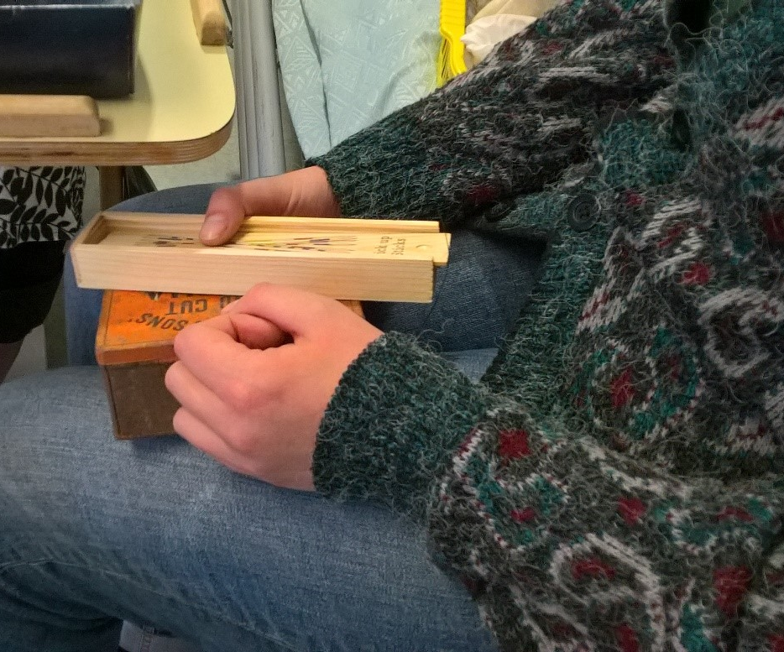
What would you do more of (and ensure you built in the funds to do it at the bid-writing stage)?
8 members of the Conwy Culture Centre project management team and staff responded to this question as part of the final evaluation of the project. On reflection, the main elements they would have built into the planning and budgeting at the bid-writing stage include increased staffing levels at ‘pinch points’ in the project, more space generally to work with people and collections, and a flexible contingency budget that would have enabled them to do more interpretation and outreach work, and commission staff at the pinch points. Many of these reflective ideas can be incorporated into future planning and funding applications. Their responses are direct quotes and they have been post-categorised under main headings:
Staffing
Increase project staff – however, the way we did this has meant that core staff know the project well and there is sustainability built into the project.
I would put more staff time / paid roles into the budget. At various times it would have been effective and efficient to have had more dedicated project staff to use.
Working with people and collections
Providing accredited learning opportunities with partner providers.
More outreach in the rural area including more satellite rural exhibitions.
Build partnerships with other major events / cultural organisations.
Interpretation
More funding for interpretation.
Generated more digital interpretive content.
Workforce development
More time and money on the staff training on how to run the building.
A greater knowledge of the maintenance contracts and the obligations from the outset.
Capital works and equipment
Ensure that there was an actual contingency (not a costed risk register for the build).
I would have built the public areas of the centre at least 25% bigger as both display and community room space is at a premium.
Roofed area outside.
Interactive white board / projector.
Storage space on the ground level.
Larger work room for staff or less furniture in there so there is more space to work.
Bigger searchroom for archives.
Marketing
Some bigger cultural events to launch the project (projections etc).
- 10 -

Slide 11
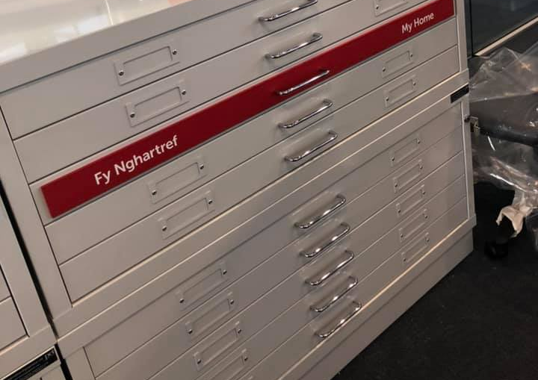
What do you think other organisations can learn from your experiences on the Conwy Culture Centre project?
8 members of the Conwy Culture Centre project management team and staff responded to this question as part of the final evaluation of the project. The main things that they feel other organisations could learn from their experiences focus on the level of time and staff resource required to prepare interpretation; how they worked with the community positively and handled quite difficult situations at times; the cost-effective solutions they have developed in-house to manage collections; and the importance of spending time to think about how spaces will work and operate in practice. Their responses are direct quotes and they have been post-categorised under main headings:
Interpretation
Do the research and interpretive content in-house. Allow sufficient time for this element and a dedicated person (grant-funded) to carry out this element of the work.
Interpretation is always ten times more time-consuming than expected, especially the amount of research needed by staff.
Working with collections
I think the process we developed for barcoding our heritage collections which we did ourselves on a low budget, and then using this to move collections and build a new locations database was a real (if unglamorous) success that it would be helpful to share.
Working with communities
The importance of working with the local community to create a positive dialogue.
Other organisations could learn the power of the people from this project. The Culture Centre was built with the people in mind throughout and it really did pay off. The feedback we have received from the local people has been very positive.
Working with others
Partners can work well together, we’ve enjoyed working with colleagues, and getting a better understanding of how the café operates for example.
There’s give and take when designing a shared public space, you can’t win all the discussions.
Momentum
It’s very difficult to change culture within internal departments and this needs a lot of energy.
Not to be downhearted if a pandemic strikes!
Capital works and equipment
Think about the space, storage and sound spill.
- 11 -

Slide 12
future and legacy

Slide 13
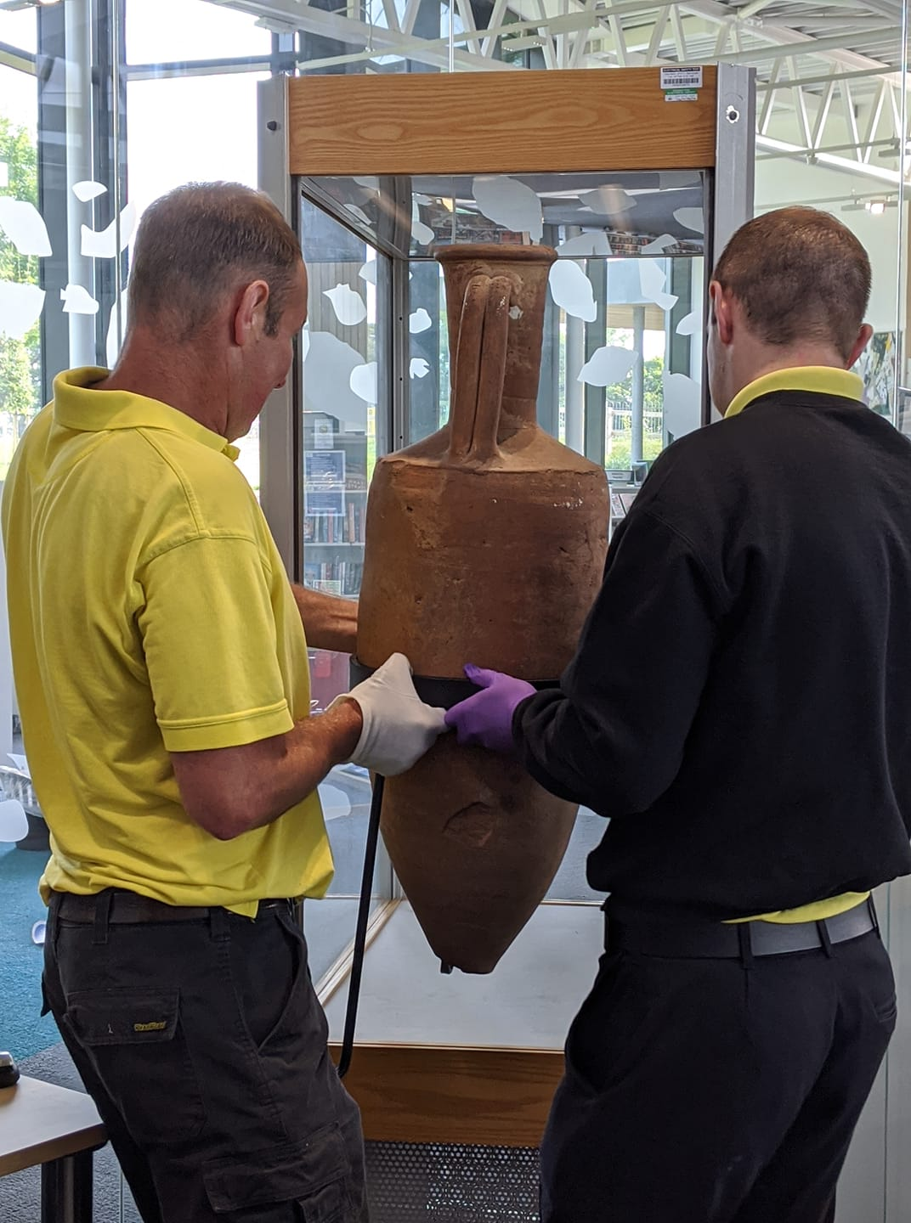
The future of Conwy Culture Centre
The Covid-19 pandemic has had a major impact on library, archive and museum services over the last 12 months. Services have had to quickly adapt and change the way they do things, and mainly rely on digital engagement with staff, the public and partners. It has made us all think differently about the way we work, the spaces we use and projects that we can do in order to protect people and engage with them more creatively. The effects on the economy and people’s wellbeing are unquantifiable at this stage, but there is some certainty that individuals and services are going to be permanently changed as a result of experiences during the pandemic.
These changes are not necessarily negatives – people have gained new skills in using new technologies, they are spending more time outdoors, there is more focus on wellbeing and the value of the arts and heritage, and people have found ways to connect with each other through cultural activity online. Conwy Culture Centre, with its airy and modern building, facilities, outreach programmes and sensory garden, is ideally placed to capitalise on this ‘new normal’.
Conwy Culture Centre was only open for a short period when the Covid-19 pandemic led to Welsh Government legislation that required services to close, and at times, restrict the services they could offer. Essentially that period of opening could be viewed as a useful ‘trial’ from which a lot of learning was gained.
Through the evaluation process, Conwy Culture Centre’s management team and staff were asked to think about how the centre is going to emerge and recover from the effects on services as a result of the Covid-19 pandemic. This question was contextualised within a ‘vision for the future’ of the centre and the services it can provide and how it can work with communities.
The responses from the 10 management team and staff members have been collated and post-categorised in this section. Some of the responses include suggestions for financial sustainability and income generation for Conwy Culture Centre. These responses, as well as the learning that has been gained from the project, have informed the recommendations that have been put forward in this report.
- 13 -

Slide 14
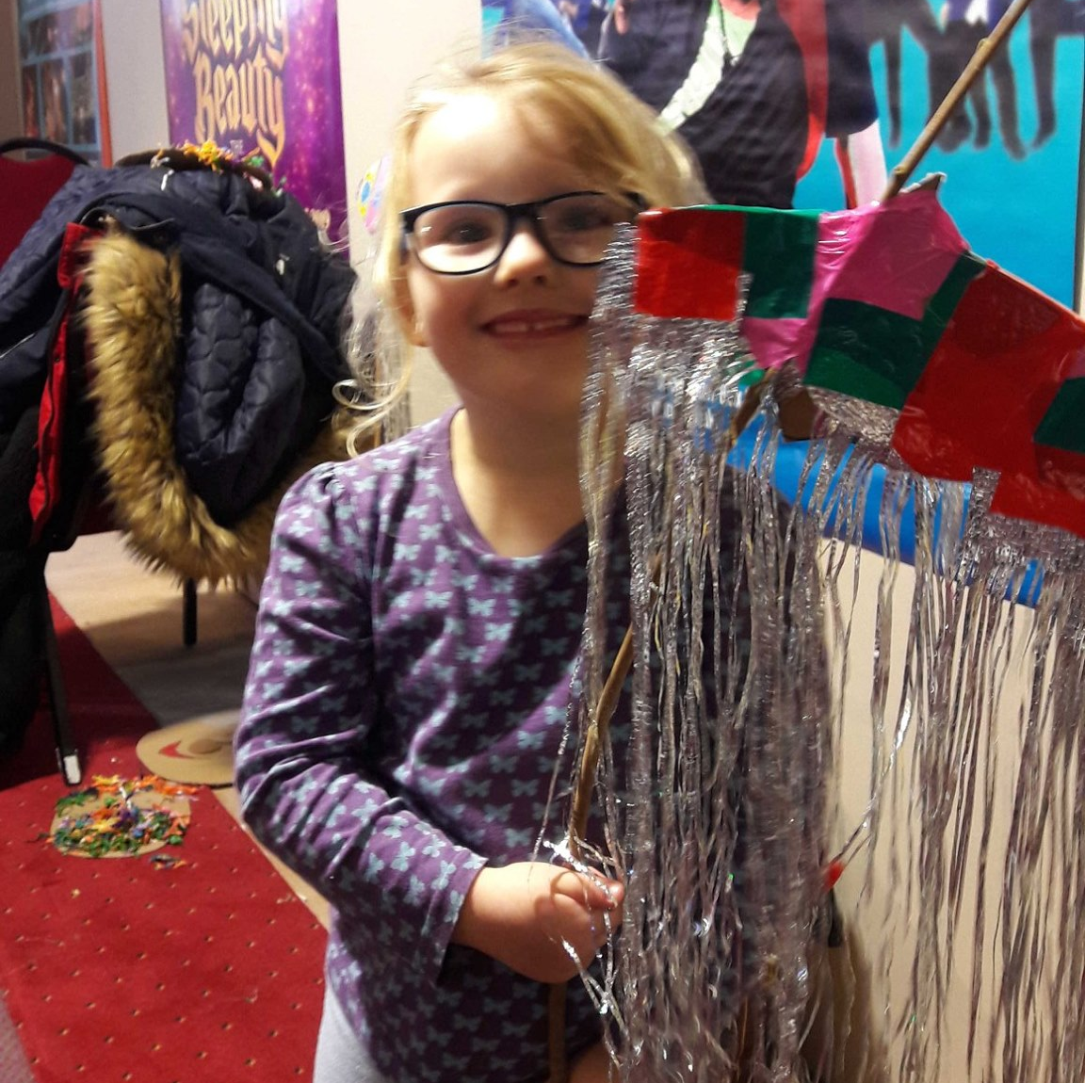
What is your vision for the future of the project and what would you like to see happen in order to grow your services and engage with audiences over the next five years?
Working with communities
Being able to book community groups and schools in regularly.
Re-establish the community-based success, on a multi-platform basis if required to ensure compliance with Covid-19 regulations.
Increase our physical visits when allowed, especially schools.
Continue to work with disadvantaged communities.
Use the outdoor space (amphitheatre) for small scale events e.g. music, storytelling from the archives.
It would be fabulous to be able to welcome all our current and new customers back in to the building, restarting library story time and possibly continuing with the online story times.
Add in-person outreach activities as covid restrictions are lessened.
I don’t think it is going to be an issue re-engaging with our traditional audiences but I think we could return to doing some outreach with non-traditional audiences, using ideas that worked for the Culture Centre project.
I think people have missed the opportunity to engage face-to-face on creative projects so hopefully there will be even more demand after all this.
Reaching out and engaging with schools will be an engagement priority.
Themed heritage days would be good, to bring the local community together regarding localised histories.
In five years I think it would be beneficial to have opened the doors to more diverse community groups, classes, clubs and possibly discussions and talks from the staff expertise. Perhaps also to fill in other slots that are missing locally, such as a venue space for the community.
We’ll need to develop a programme which helps with confidence-building, perhaps a series of projects which are all wellbeing focused, informal and small groups before we can expect normal delivery to resume. I think we need to take this approach with for staff too, who will need to readjust again.
Continue the activity programme.
I would like us to continue to develop programmes that blend our arts, culture and archive offer into unique experiences for visitors and learners, tying in with the delivery of the new Culture Strategy.
I hope to see all our services used in many ways, with lots of external groups coming in and making use of our stone circle and hire spaces.
- 14 -

Slide 15
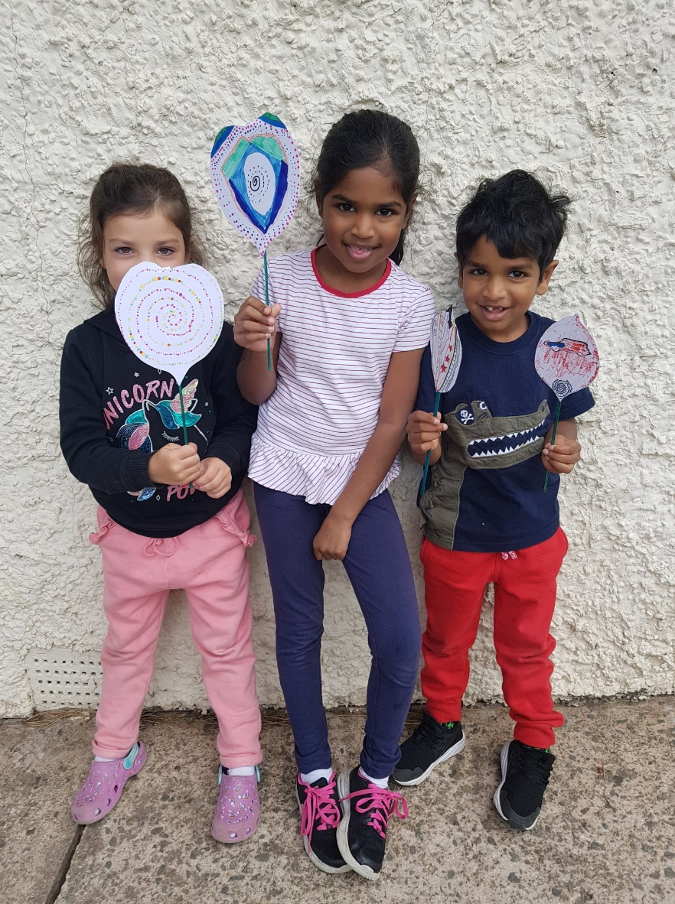
Enterprise and income generation
Have a small shop.
We need to make partnerships that will bring us some grant funding for our outreach work. For example, staff time on running accredited courses needs to be paid for as an additional resource, not out of core staff time.
As tourism recovers post-Covid, I have some ideas about monetising ancestral tourism.
The community room is a great space, and people are keen for small meetings and face-to-face events to take place – this will certainly assist in income generation.
As Conwy has a high tourist interest, it may be an idea to have rentable lockers available for those whom may want to stay in the centre and not leave their bags around and to be used by those attending sessions in our community space.
I would like to think that people will be keen to attend perhaps creative masterclass sessions where we can charge a fee to take part.
Marketing
We need to tell people what goes on at the centre through active promotion at the centre, e.g. digi-screens for people passing the building as well as video clips etc available online, a meet the staff, see staff unpacking boxes in the basement, or whatever is of interest.
Access
In the short term, mainly from the perspective of the Archive Service, the priority is to open up for physical visitors and then increase opening hours as restrictions allow for additional staff / visitors to be on site.
Digital engagement
We need to invest more time in the digital side of our work which is already happening with a new portal / website.
We are going to be working to a new digitally focused marketing plan for the Culture Centre.
Increase our digital audiences.
Cultural leadership
I want the centre to be at the forefront of innovative cultural programming that will reach those least likely to participate in cultural activity.
I want us to further develop our role, with partners, as a space for creating cultural ambassadors who can help to deliver culture-led regeneration and renewal post-covid.
Staffing capacity
I think the problem will not be finding audiences that want to engage with us, it will be lack of staff capacity.
- 15 -

Slide 16
“This has been a real team project and that needs to be credited.”
“It has been a pleasure to be involved in this project and I can’t believe it’s nearly over!”
“The staff also have worked so hard to bring the vision together and it has brought staff from different departments together to become close colleagues, but also friends, which makes the building a lovely place to work.”
“Diolch – thank you, it has been a source of great pride for me to be involved in this project. To open a new public library facility is a rare career event. Conwy and the team of staff delivering this project have done us and the people of Conwy and beyond, proud.”

